Slide 1
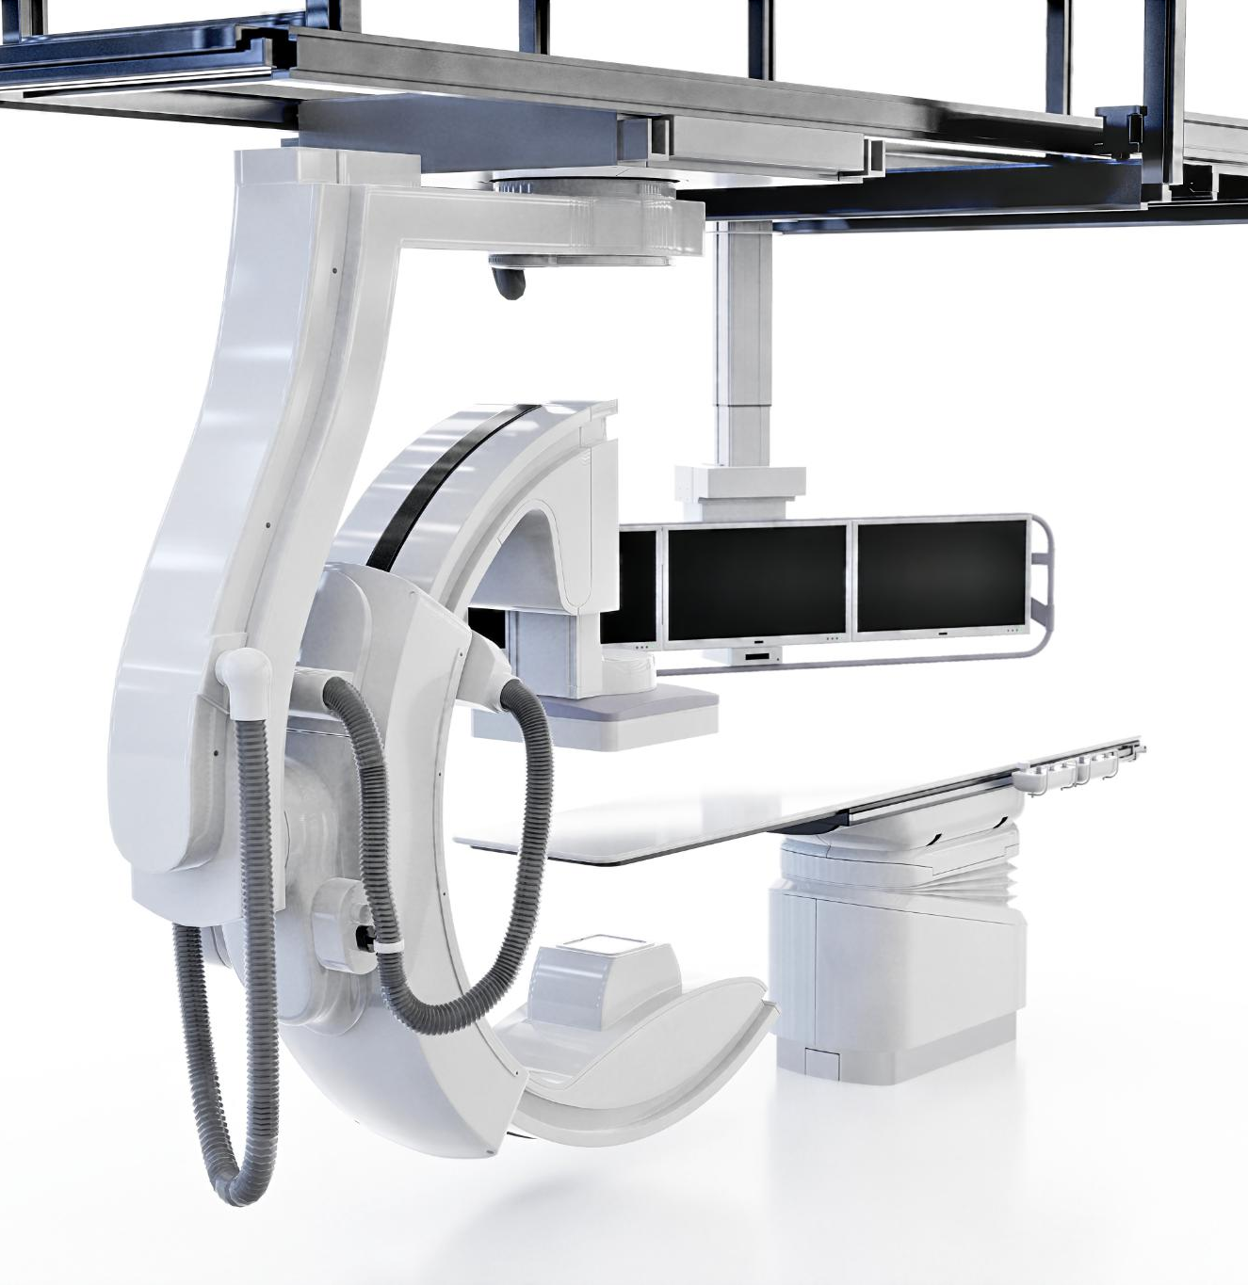
Safety Improvements for Mobile CT Scanner Units: Protecting Patients and the Public
Enhancing protection against radiation exposure risks
Notes:
---
This presentation explores the safety enhancements for mobile CT scanner units, focusing on protecting both patients and the public from potential radiation risks. We will cover the background of mobile CT services, analyze radiation leakage concerns, propose engineering solutions, discuss safety protocols, and highlight expected outcomes.
Image source: Microsoft 365 content library

Slide 2
Analysis of Radiation Leakage Risks
Notes:
Evaluating radiation emission mechanisms and structural vulnerabilities is essential to minimizing exposure risks to patients, staff, and the public around mobile CT units.

Slide 3
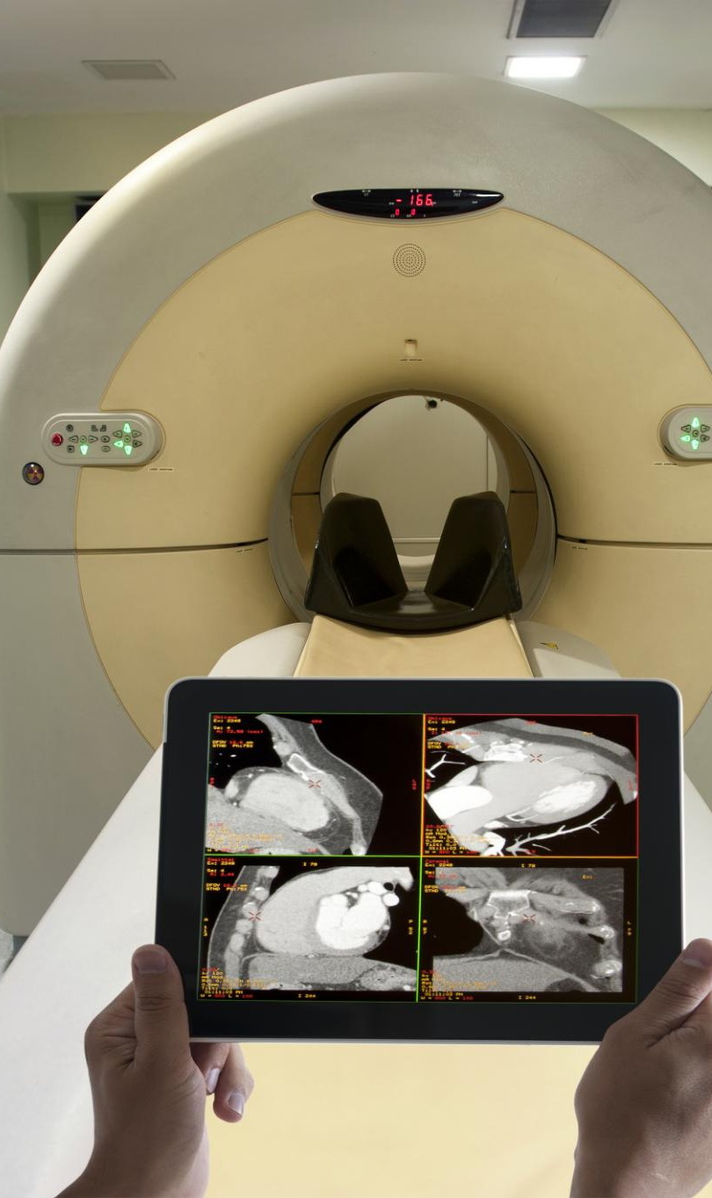
Mechanisms of Radiation Emission From CT Scanners
Radiation Emission Timing
  Radiation is emitted mainly during active imaging cycles in CT scanners, crucial for capturing internal images.
Radiation Propagation
  The ionizing radiation propagates through specific paths, important for identifying potential leakage and exposure.
Exposure Risk Identification
  Understanding radiation mechanisms aids in pinpointing exposure risks and enhancing safety measures.
Notes:
---
CT scanners emit ionizing radiation primarily during imaging cycles. Understanding how this radiation propagates helps identify potential leakage points and exposure scenarios.
Image source: Microsoft 365 content library

Slide 4
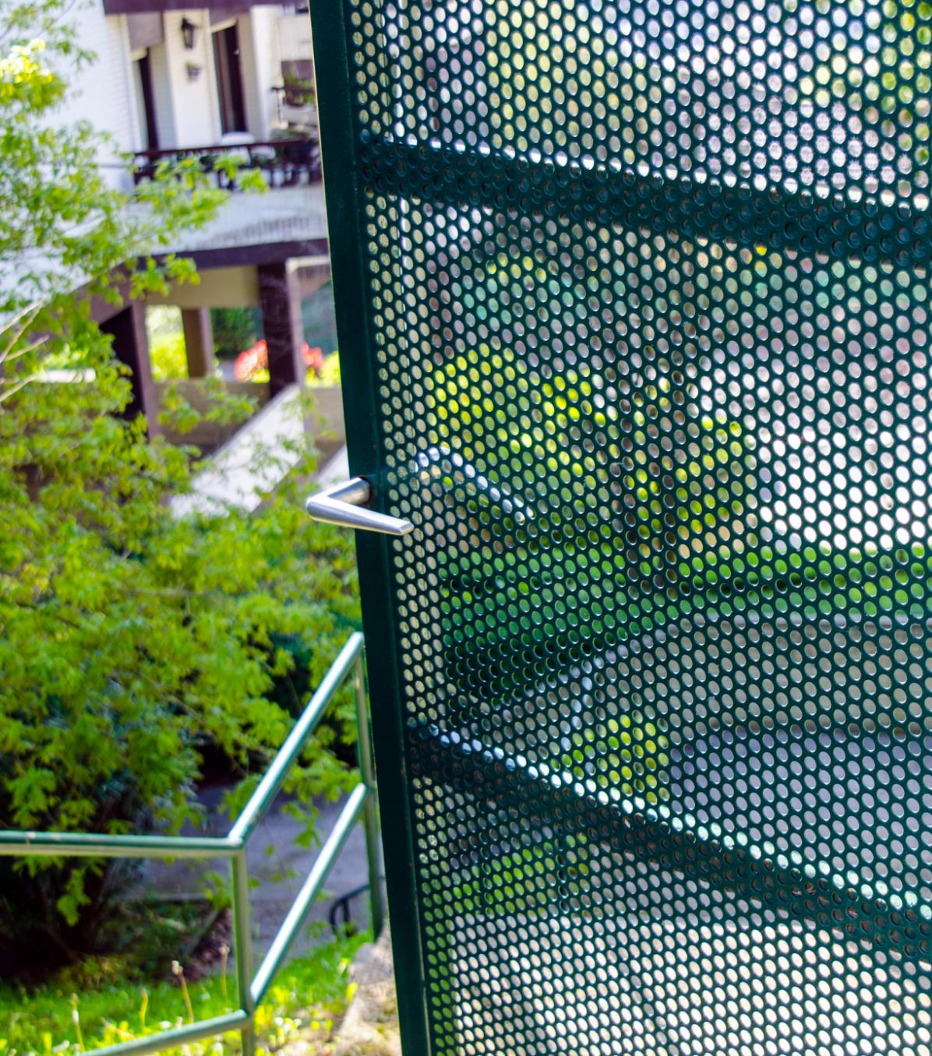
Structural Weaknesses in Shielding Cages
Design Limitations
  Shielding cages in mobile units sometimes have structural gaps that compromise radiation protection.
Material Insufficiency
  Insufficient thickness of shielding material increases radiation leakage risk in mobile units.
Notes:
---
Mobile units use shielding cages that may have design limitations, such as gaps or insufficient material thickness, which can allow radiation leakage and increase risk.
Image source: Microsoft 365 content library

Slide 5
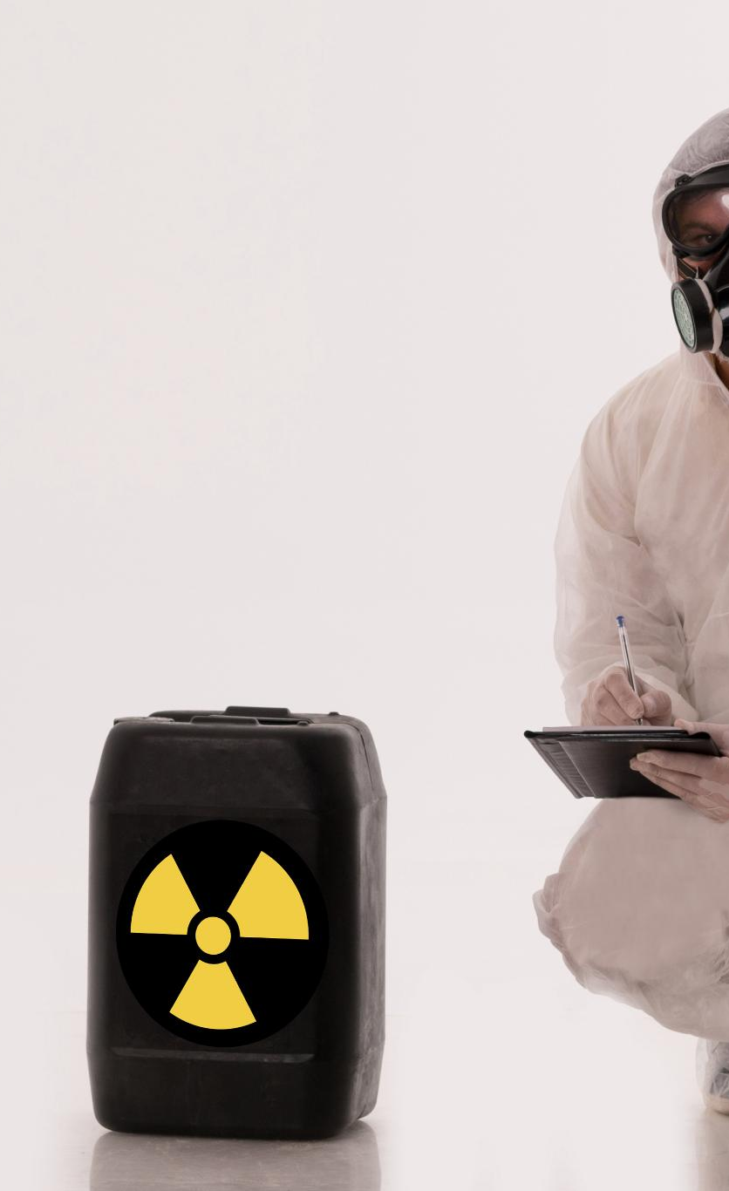
Health Risks for Bystanders and Individuals with Implanted Devices
Radiation Leakage Risks
  Radiation leakage can harm bystanders and individuals with implanted medical devices, requiring careful monitoring.
Safety Measures Importance
  Strict safety protocols and exposure limits protect vulnerable individuals from harmful radiation effects.
Implanted Device Sensitivity
  Patients with sensitive implanted devices need additional safeguards against radiation exposure risks.
Notes:
---
Radiation leakage poses particular risks to bystanders and patients with sensitive implanted devices, necessitating stringent safety measures and exposure limits.
Image source: Microsoft 365 content library

Slide 6
Proposed Engineering Solutions for Enhanced Safety
Notes:
Innovative engineering approaches can significantly improve shielding effectiveness and radiation monitoring, thereby enhancing safety for all stakeholders.

Slide 7
Redesigning Shielding with Advanced Materials
Enhanced Attenuation Materials
New shielding materials offer improved attenuation properties to effectively reduce leakage.
Maintaining Mobility
The redesigned shielding ensures units remain mobile without compromising protection.
Operational Efficiency
Improved shielding materials contribute to maintaining operational efficiency of units in the field.
Notes:
---
Utilizing new shielding materials with greater attenuation properties can reduce leakage while maintaining mobility and operational efficiency of the units.
Image source: Microsoft 365 content library

Slide 8
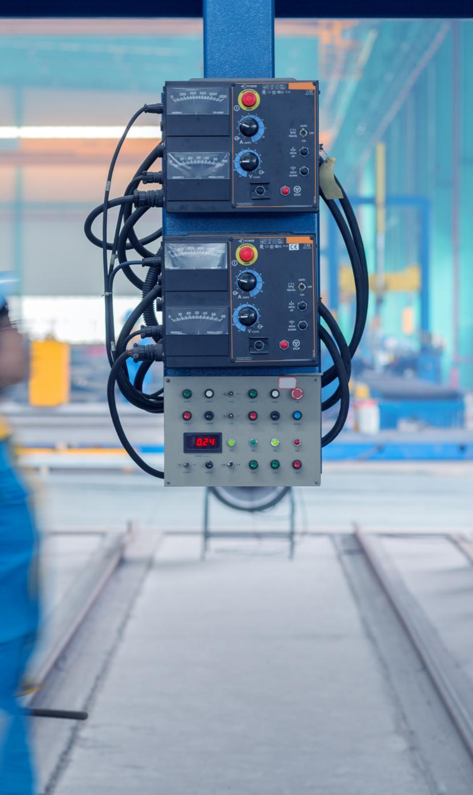
Implementation of Real-Time Radiation Monitoring Systems
Continuous Radiation Feedback
  Sensors continuously monitor radiation levels and provide immediate feedback for effective safety management.
Immediate Unsafe Exposure Detection
  Real-time data enables fast detection of unsafe radiation levels, preventing potential hazards.
Enhanced Operational Safety
  Real-time monitoring systems improve safety protocols and control in radiation-prone environments.
Notes:
---
Integrating sensors that provide continuous radiation level feedback allows immediate detection of unsafe exposures and enhances operational safety control.
Image source: Microsoft 365 content library

Slide 9
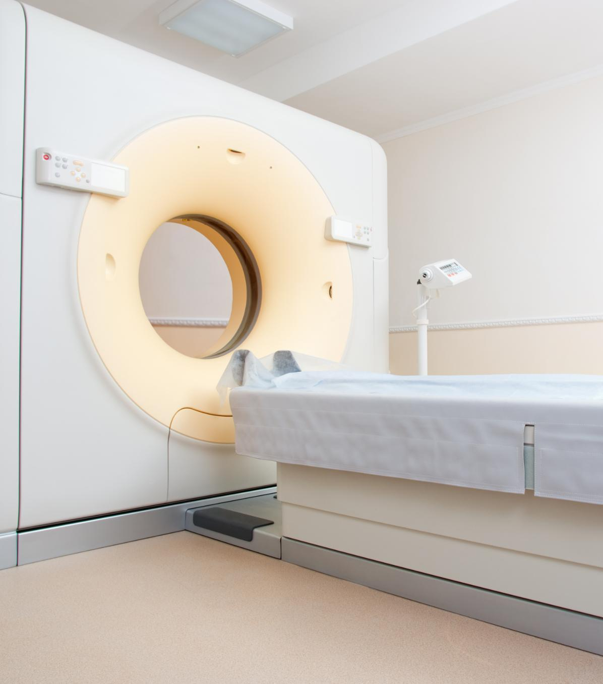
Additional Patient and Staff Protection Measures
Protective Barriers
  Supplementary barriers help shield patients and staff from unnecessary radiation exposure during imaging procedures.
Safety Protocols
  Implementing strict safety protocols ensures minimal radiation dose for both patients and healthcare workers.
Notes:
---
Introducing supplementary protective barriers and safety protocols ensures that both patients and medical staff minimize their radiation exposure during imaging procedures.
Image source: Microsoft 365 content library

Slide 10
Operational Safety Protocols and Compliance
Notes:
Clear operational guidelines and adherence to established standards are critical to maintaining safety and regulatory compliance in mobile CT imaging.

Slide 11
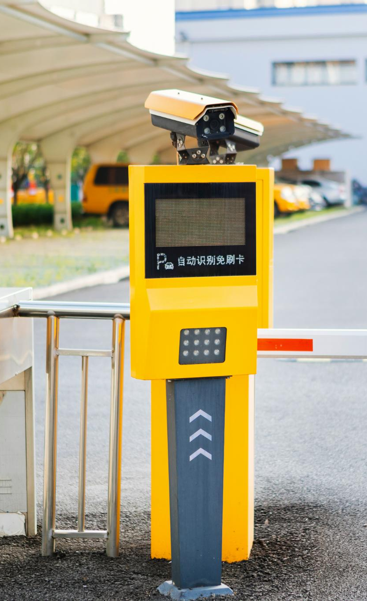
Establishing Exclusion Zones and Clear Signage
Safety Perimeter Zones
  Establishing exclusion zones creates a physical boundary to keep people safe from radiation exposure.
Visible Radiation Signage
  Clear and visible warning signs alert individuals about radiation hazards within exclusion zones.
Preventing Unauthorized Access
  Signage and exclusion zones help prevent unauthorized or accidental entry into hazardous radiation areas.
Notes:
---
Defining safety perimeter zones with visible signage helps prevent unauthorized or accidental exposure to radiation during scanner operation.
Image source: Microsoft 365 content library

Slide 12
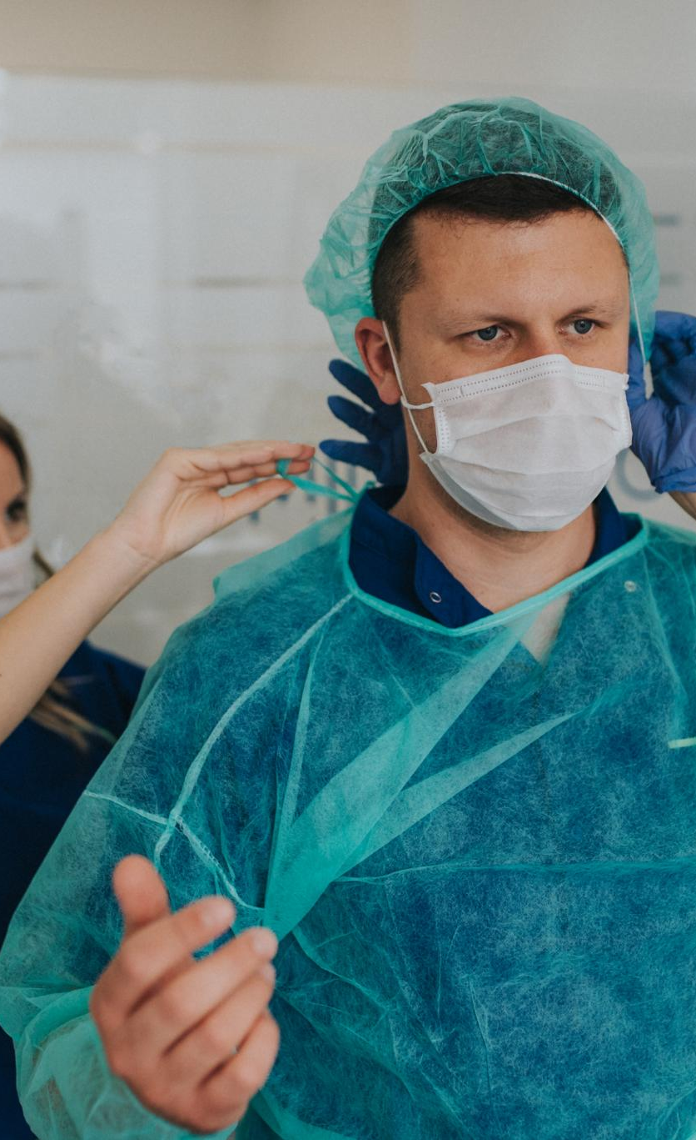
Staff Training and Patient Guidance Procedures
Comprehensive Staff Training
  Thorough training equips staff with knowledge of safety protocols, ensuring consistent application and risk reduction.
Clear Patient Guidance
  Providing patients with clear instructions reduces exposure risks and supports a safer healthcare environment.
Safety Culture Enhancement
  Together, training and guidance foster a culture of safety that benefits both staff and patients.
Notes:
---
Comprehensive training ensures staff understand safety protocols, while clear patient guidance minimizes exposure risks and enhances overall safety culture.
Image source: Microsoft 365 content library

Slide 13
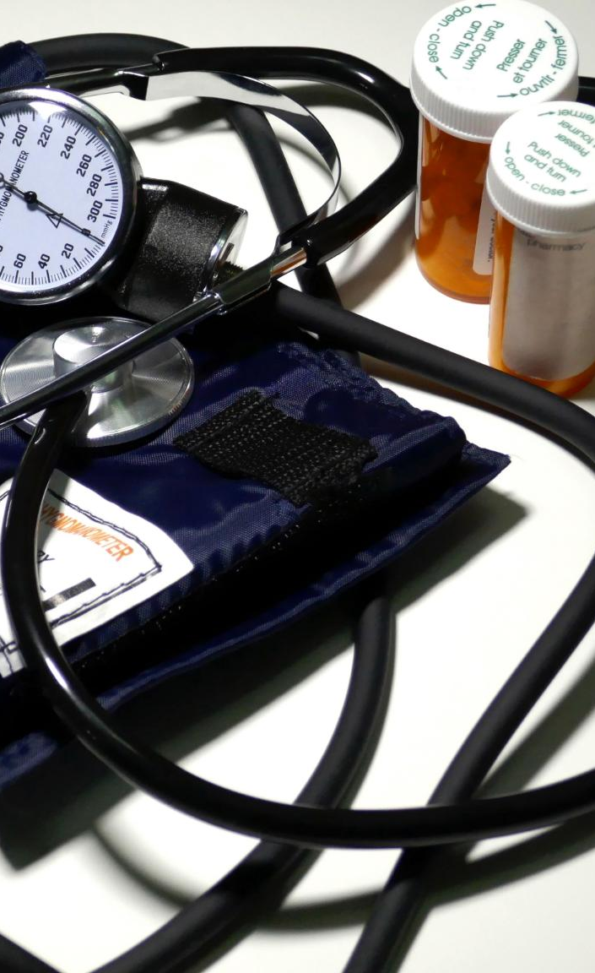
Certification, International Standards, and Rigorous Testing
Compliance with Safety Standards
  Mobile CT units must meet international safety regulations to ensure user and patient protection.
Shielding Effectiveness Testing
  Rigorous tests validate the shielding of mobile CT units to prevent radiation leakage.
Operational Safety Validation
  Testing procedures confirm that mobile CT units operate safely under all conditions.
Notes:
---
Mobile CT units must comply with international safety standards and undergo rigorous testing to validate shielding effectiveness and operational safety.
Image source: Microsoft 365 content library

Slide 14
Expected Outcomes and Building Public Trust
Notes:
Implementing these improvements will boost patient and community safety, increase confidence in mobile diagnostic technologies, and support broader healthcare accessibility.

Slide 15
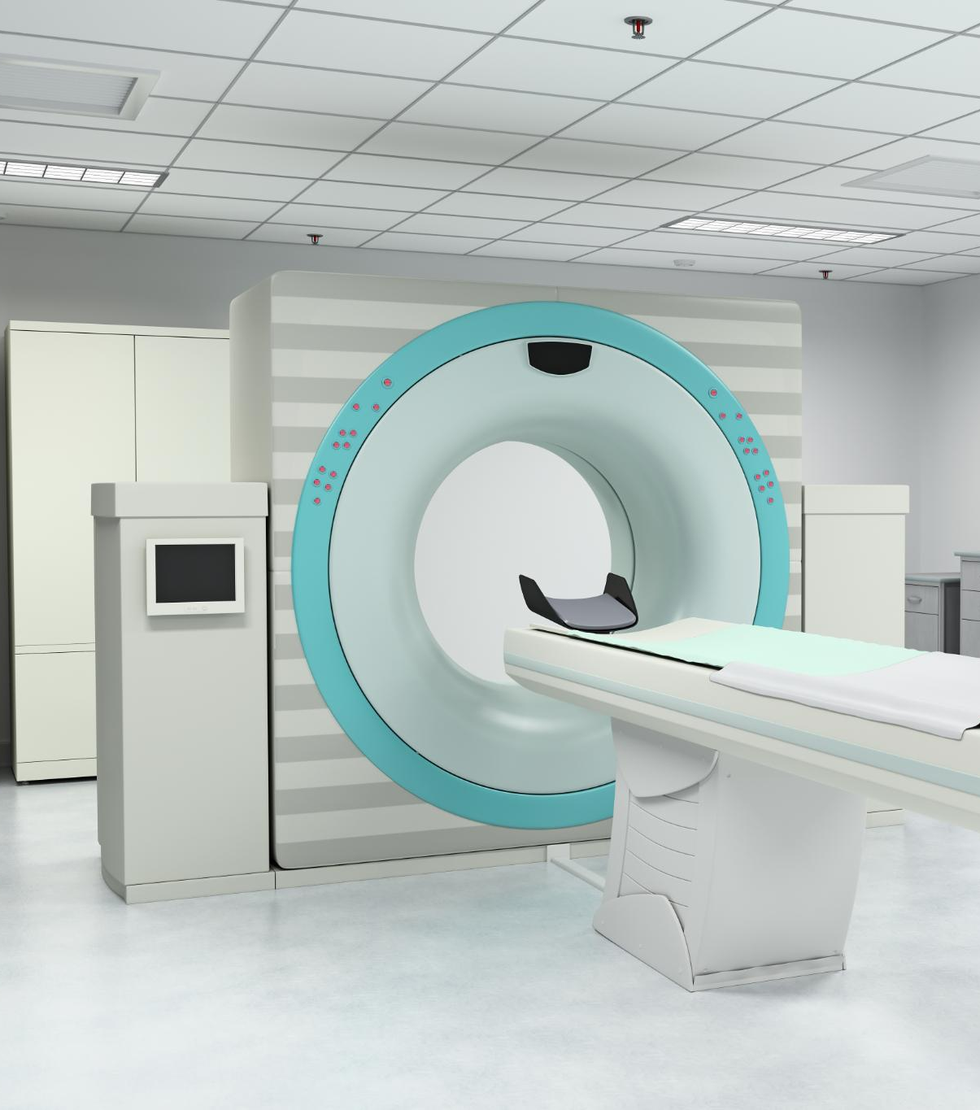
Improvements in Patient and Community Safety
Radiation Exposure Reduction
  Enhanced shielding minimizes radiation risks to patients and healthcare workers during mobile CT procedures.
Safety Protocols Implementation
  Strict safety protocols ensure protection of patients, staff, and community during mobile CT scanning.
Notes:
---
Enhanced shielding and protocols significantly reduce radiation exposure risks, protecting patients, staff, and the public during mobile CT scanning.
Image source: Microsoft 365 content library

